Slide 1


Ultra-Wideband Swarm Ranging
IEEE International Conference on Computer Communications
10-13 May 2021 // Virtual Conference
SOUTHEAST
UNIVERSITY
Feng Shan, Jiaxin Zeng, Zengbao Li,
Junzhou Luo, Weiwei Wu
Southeast University, Nanjing, China
Notes:
Hello, everybody, welcome to my presentation.
My name is Feng Shan. I am an associate Professor from Southeast University, Nanjing, China. The paper I will be presenting today is titled “Ultra-Wideband Swarm Ranging”

Slide 2
Outline
Introduction
Preliminary
Swarm Ranging Protocol
Experiment
Conclusion
Notes:
There are five parts in my presentation.

Slide 3
Outline
Introduction
Preliminary
Swarm Ranging Protocol
Experiment
Conclusion
Notes:
First let me give the introduction.

Slide 4
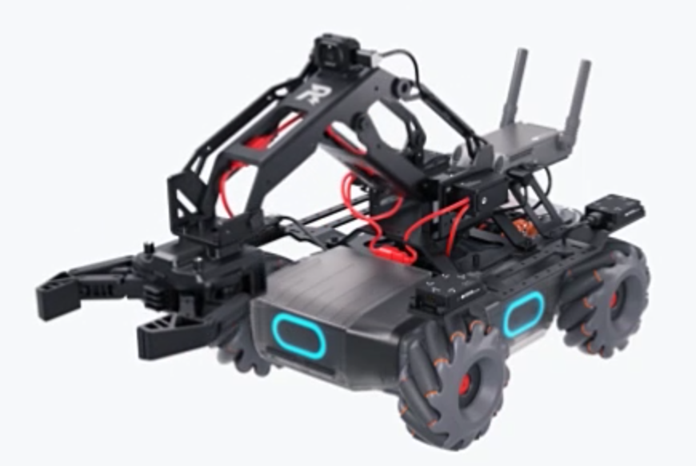
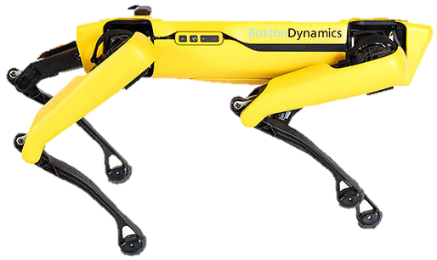
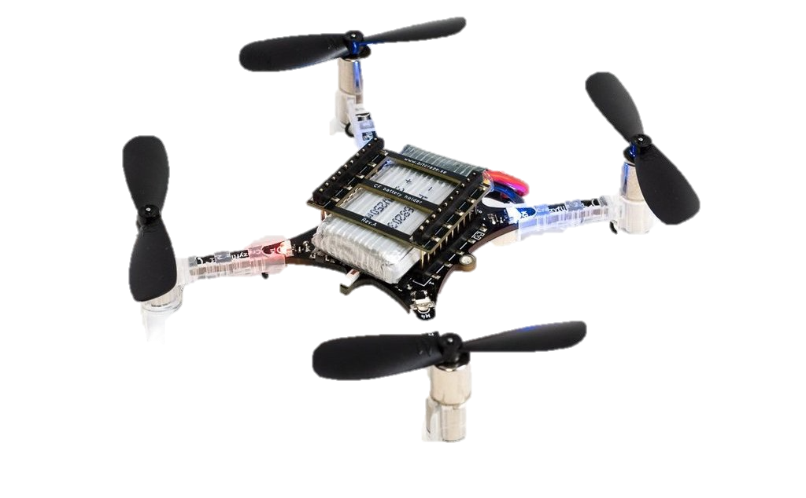
Swarm of robots and devices
Aerial/ground robots, wearable/portable devices are becoming smaller, lighter, cheaper, and popular.
Tens and thousands of them are to form a swarm to complete complicated cooperative tasks.
A team of indoor drones search for given targets
A swarm of small robots explore and map unknown indoor environments
An army of legged robot dogs battle in a deep forest
Crazyflie 2.1
RoboMaster EP
SPOT
Notes:
This micro drone is the Crazyflie from Bitcraze
This wheeled robot is the RoboMaster EP from DJI
This legged dog is the SPOT from Boston Dynamics

Slide 5
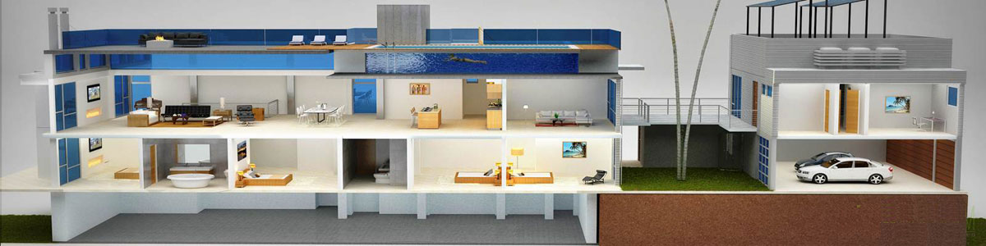
Dynamic and dense swarm features
Dynamic and dense swarm
large number
high mobility
short distance.
When no outside supportive infrastructures, critical to
Real-time internal distance ranging for localization
Low latency ad hoc networking and communication
Notes:
We conclude that such swarms are dynamic and dense,
We conclude three important features for robots and devices in such a swarm: large number, high mobility and short distance.
such as no gps for localization, no wireless acess points for communication....

Slide 6
Ultra-wideband swarm ranging protocol
Ultra-wideband (UWB) wireless technology support simultaneously ranging and communication.
Our target is to design a UWB ranging protocol for a dynamic and dense swarm of robots and devices.
Notes:
we therefore propose to use ultra-wideban within swarms, because ...

Slide 7
Challenges to design such a ranging protocol
Design a simple yet efficient protocol
A large number share the same UWB channel.
Inappropriate cause conflicting and high computation cost.
Design a adaptive and robust protocol
High mobility requires high frequency ranging.
Ranging frequency should be reduced whenever necessary.
Also cause wireless channel unstable and packet lose.
Design a scalable and compatible protocol
Message has limitation space for dense neighbor.
Support existing networking and localization protocols.
Notes:
It is challenge to ...., Because large number robots or devices in a swarm
It is challenge to ...., Because robots or devices move dynamically
It is challenge to ...., Because robots or devices dense

Slide 8
Outline
Introduction
Preliminary
Swarm Ranging Protocol
Experiment
Conclusion
Notes:
we now present some preliminary knowldges

Slide 9
Ultra-Wide Band (UWB) technology
UWB propagates data at high bit rates over a wide frequency spectrum(3.1~10.6GHz)
So time sensitive that an accurate distance can be calculated using transmit and receive timestamps
Ranging accuracy around 10 cm
GPS
LTE
WiFi
LTE
WiFi
UWB
1.6
1.9
2.4
2.5
3.1
5.0
10.6
Frequency spectrum(GHz)
Notes:
uwb is a differnet from wifi, lte and gps,

Slide 10
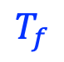
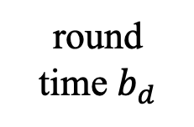
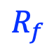
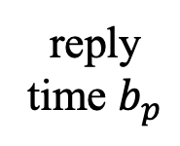
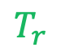
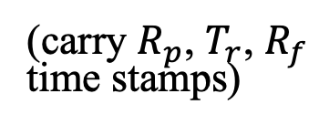
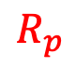
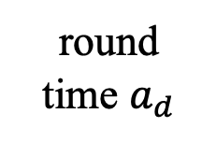
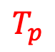
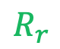
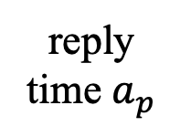
Double-sided two-way ranging (DS-TWR)
Double-sided two-way ranging (DS-TWR)
An existing ranging protocol from IEEE Standard 802.15.4-2011 is later improved by industry giant Decawave.
Distance calculated after exchanging four messages
poll, response, final, and report messages.
$$R_{p}$$
reply
time $b_{p}$
$$T_{r}$$
round
time $b_{d}$
$$R_{f}$$
B
time
poll
response
final
(carry $R_{p}$, $T_{r}$, $R_{f}$
time stamps)
report
round
time $a_{d}$
reply
time $a_{p}$
time
A
$$T_{p}$$
$$R_{r}$$
$$T_{f}$$
Notes:
We briefly introduce Double-sided two-way ranging protocol, an improvement of the ranging protocol from IEEE Standard.
let the two sides exchange messages, then ...
A initialize the process by send a poll message, then B reply a ...
These messages generate six useful timestamps, in color

Slide 11
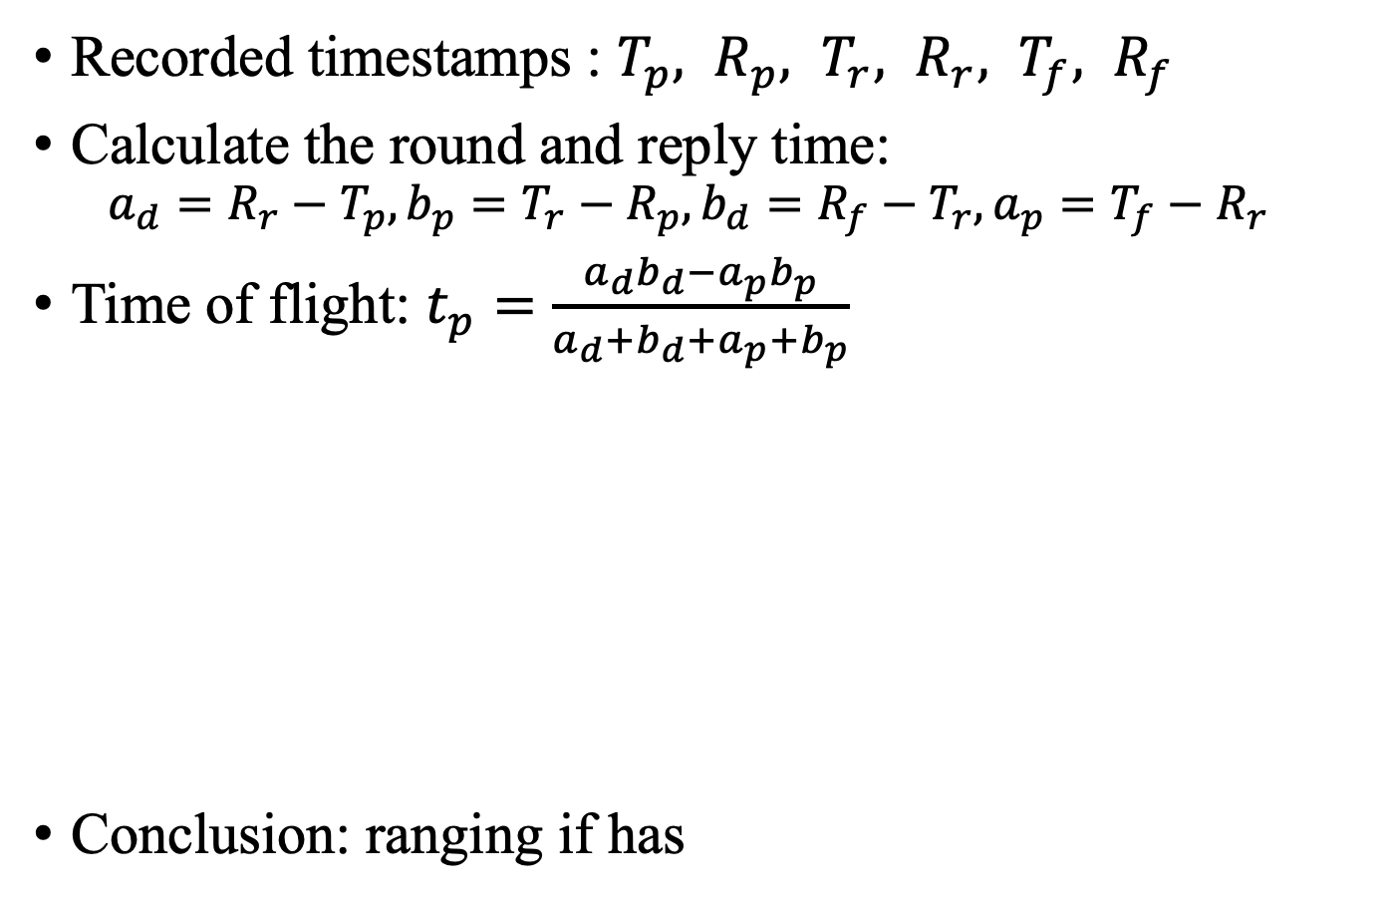
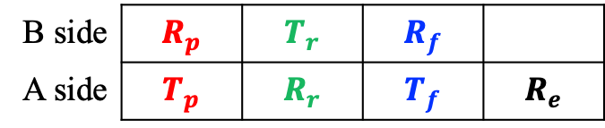
Double-sided two-way ranging (DS-TWR)
Recorded timestamps : $T_{p}, R_{p}, T_{r}, R_{r}, T_{f}, R_{f}$
Calculate the round and reply time:
$$a_{d}=R_{r}−T_{p}, b_{p}=T_{r}−R_{p}, b_{d}=R_{f}−T_{r}, a_{p}=T_{f}−R_{r}$$
Time of flight: $t_{p}=\frac{a_{d}b_{d}−a_{p}b_{p}}{a_{d}+b_{d}+a_{p}+b_{p}}$
Conclusion: ranging if has
$$R_{p}$$
reply
time $b_{p}$
$$T_{r}$$
round
time $b_{d}$
$$R_{f}$$
B
time
poll
response
final
(carry $R_{p}$, $T_{r}$, $R_{f}$
time stamps)
report
round
time $a_{d}$
reply
time $a_{p}$
time
A
$$T_{p}$$
$$R_{r}$$
$$T_{f}$$
B side | $$R_{p}$$ | $$T_{r}$$ | $$R_{f}$$
A side | $$T_{p}$$ | $$R_{r}$$ | $$T_{f}$$ | $$R_{e}$$
Notes:
By these formulas, the time of flight and the distance can be calculated.
As a conclusion, ranging is possible if we have a table like this one.

Slide 12
Simple extension of standard protocol
Use the token ring method to control the ranging process.
Token owner initializes ranging process with all its neighbors, one by one. Then, pass the token to the next in the ring.
Inefficient: messages heard by all neighbors, but are mostly ignored.
DS-TWR
Token Ring
A
B
C
Notes:
there is a simple extension of such standard protocol to the swarm sencario.
for exmaple a first holds the token and start rangign with neighbhors, then passes the token to B. B start ranging and passes token to C.
however, when A and B are exchanging messages, C can hear them all, because of the broadcast nature of the wireless communication, but they are ignored, which is quite inefficient

Slide 13
The basic idea of swarm ranging
Define one single message named ranging message
Each side periodically broadcasts the ranging message
A
A
C
B
A
C
B
ranging message
Broadcast ranging message
B
C
Notes:
This motivated us to design a new protocol that take advantiage of the broadcast nature of wireless communication.
...
Each broadcasted message can be received by the other two sides. Then every message generates three timestamps, i.e., one transmit and two receive timestamps.
We can see that each pair has two rounds of message exchanges and generate sufficient timestamps to calculate the ranging value for each pair.

Slide 14
The basic idea of swarm ranging
To deal with the challenges of the dynamic and dense swarm, the following questions must be answered.
Q1: How to design the ranging message so that sufﬁcient timestamps are carried?
Q2: Does the enlarged transmit period affect accuracy?
Q3: How does high mobility affect the ranging accuracy?
Q4: How often should the ranging message be broadcasted?
Q5: What if message lost or ranging frequency mismatched?
Q6: How to handle dense neighbors?
Q7: Does the swarm ranging protocol supports or compatible with other higher level protocols?

Slide 15
Outline
Introduction
Preliminary
Swarm Ranging Protocol
Experiment
Conclusion

Slide 16
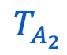
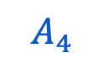
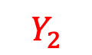
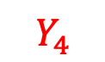
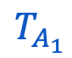
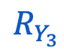
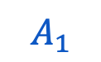
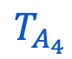
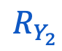
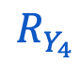
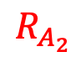
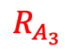

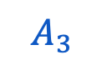
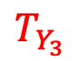
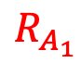
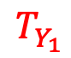
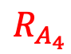
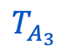
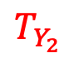
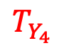
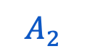
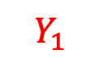
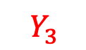
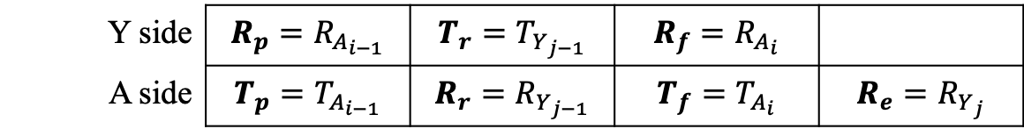
Ranging message and ranging table
Each ranging message includes
The last transmit timestamp
All receive timestamps since last transmit
Ranging table keeps only few timestamps
$$R_{A_{1}}$$
$$T_{Y_{1}}$$
$$R_{A_{2}}$$
$$T_{Y_{2}}$$
$$R_{A_{3}}$$
$$T_{Y_{3}}$$
$$R_{A_{4}}$$
$$T_{Y_{4}}$$
Y
$$A_{1}$$
$$Y_{1}$$
$$A_{2}$$
$$Y_{2}$$
$$A_{3}$$
$$Y_{3}$$
$$A_{4}$$
$$Y_{4}$$
A
$$T_{A_{1}}$$
$$R_{Y_{1}}$$
$$T_{A_{2}}$$
$$R_{Y_{2}}$$
$$T_{A_{3}}$$
$$R_{Y_{3}}$$
$$T_{A_{4}}$$
$$R_{Y_{4}}$$
Y side | $$R_{p}=R_{A_{i−1}}$$ | $$T_{r}=T_{Y_{j−1}}$$ | $$R_{f}=R_{A_{i}}$$
A side | $$T_{p}=T_{A_{i−1}}$$ | $$R_{r}=R_{Y_{j−1}}$$ | $$T_{f}=T_{A_{i}}$$ | $$R_{e}=R_{Y_{j}}$$
Notes:
we use a very simple example to introduce the ranging message, the ranging table, and how our ranging protocol works.
each ranging message ...
suppose A is ranging with Y, from the point view of A, the ranging table ...
initially, three timestamps are known before the next round of message exchange.
when a message is sent, a transmit timestamp is recorded.
since message Y2 include the last transmit timestamp and the receive timestamp since last transmit, when Y2 is received, three timestamps are updated. Now it is read to calculate the ranging value.
the ranging table is rerranged to prepare for the next round of message exchange
when sent, one timestamp recorded
when received, three timestamps updated and distance computed.
then rerrange the ranging table to prepare for the next round.
this same thing repeats

Slide 17
Ranging message and ranging table
Each ranging message includes
The last transmit timestamp
All receive timestamps since last transmit
Ranging table keeps only few timestamps
Q1 (ranging message design) is answered

Slide 18
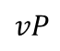
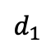
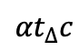
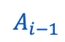
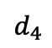
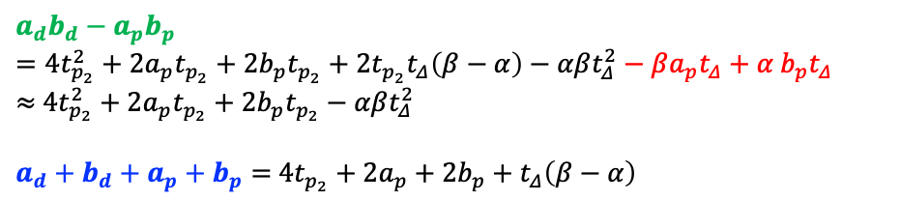
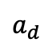
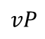
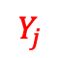




















How mobility affect ranging accuracy
Distance computed: $d_{2}$
$$vP$$
A
$$vP$$
Y
$$v$$
$$A_{i−1}$$
$$\left\{\begin{aligned}t_{p_{1}}=t_{p_{2}}+βt_{Δ} \\ t_{p_{3}}=t_{p_{2}}−αt_{Δ} \\ t_{p_{4}}=t_{p_{2}}−t_{Δ} \\ a_{d}=b_{p}+2t_{p_{2}}+βt_{Δ} \\ b_{d}=a_{p}+2t_{p_{2}}−αt_{Δ} \\ { a}_{d}≈b_{p},∵t_{Δ},t_{p_{2}}≪{a_{d},b}_{p} \\ { b}_{p}:a_{p}≈β:α \end{aligned}\right.$$
$$d_{1}$$
$$d_{2}$$
$$Y_{j−1}$$
$$d_{3}$$
$$A_{i}$$
$$Y_{j}$$
distance
$$d_{4}$$
$${βt}_{∆}c$$
$${αt}_{∆}c$$
$$t_{p_{3}}c$$
$$t_{∆}c$$
$$t_{p_{4}}c$$
$$t_{p_{1}}c$$
$$t_{p_{2}}c$$
$$b_{p}$$
$$b_{d}$$
Y
$$A_{i−1}$$
$$Y_{j−1}$$
$$A_{i}$$
$$Y_{j}$$
time
$$a_{d}$$
$$a_{p}$$
time
A
$$ToF=t_{p}^{computed}=\frac{a_{d}b_{d}−a_{p}b_{p}}{a_{d}+b_{d}+a_{p}+b_{p}}=t_{p_{2}}+\frac{t_{p_{2}}t_{Δ}\left(β−α\right)−αβt_{Δ}^{2}}{4t_{p_{2}}+2a_{p}+2b_{p}+t_{Δ}\left(β−α\right)}≈t_{p_{2}}$$
$$a_{d}b_{d}−a_{p}b_{p}=4t_{p_{2}}^{2}+2a_{p}t_{p_{2}}+2b_{p}t_{p_{2}}+2t_{p_{2}}t_{Δ}\left(β−α\right)−αβt_{Δ}^{2}−βa_{p}t_{Δ}+α{ b}_{p}t_{Δ}$$
$≈$ $4t_{p_{2}}^{2}+2a_{p}t_{p_{2}}+2b_{p}t_{p_{2}}−αβt_{Δ}^{2}$
$a_{d}+b_{d}+a_{p}+b_{p}=$ $4t_{p_{2}}+2a_{p}+2b_{p}+t_{Δ}\left(β−α\right)$
Notes:
A is moving towards Y, and exchanging messages with Y at the same time.
A transmits a message at position d1
it receives a message at position d2
transmits at d3 and receives at d4
only at d4, can A collect enough timestamps, but is the ranging result accurant? we give more relationships and establish equations
by careful analysis, the distance computed at d4 is acutly d2
that is to say, ranging results are delayed

Slide 19
How mobility affect ranging accuracy
Distance computed: $d_{2}$
$$vP$$
A
$$vP$$
Y
$$v$$
$$A_{i−1}$$
$$\left\{\begin{aligned}t_{p_{1}}=t_{p_{2}}+βt_{Δ} \\ t_{p_{3}}=t_{p_{2}}−αt_{Δ} \\ t_{p_{4}}=t_{p_{2}}−t_{Δ} \\ a_{d}=b_{p}+2t_{p_{2}}+βt_{Δ} \\ b_{d}=a_{p}+2t_{p_{2}}−αt_{Δ} \\ { a}_{d}≈b_{p},∵t_{Δ},t_{p_{2}}≪{a_{d},b}_{p} \\ { b}_{p}:a_{p}≈β:α \end{aligned}\right.$$
$$d_{1}$$
$$d_{2}$$
$$Y_{j−1}$$
$$d_{3}$$
$$A_{i}$$
$$Y_{j}$$
distance
$$d_{4}$$
$${βt}_{∆}c$$
$${αt}_{∆}c$$
$$t_{p_{3}}c$$
$$t_{∆}c$$
$$t_{p_{4}}c$$
$$t_{p_{1}}c$$
$$t_{p_{2}}c$$
$$b_{p}$$
$$b_{d}$$
Y
$$A_{i−1}$$
$$Y_{j−1}$$
$$A_{i}$$
$$Y_{j}$$
time
$$a_{d}$$
$$a_{p}$$
time
A
$$ToF=t_{p}^{computed}=\frac{a_{d}b_{d}−a_{p}b_{p}}{a_{d}+b_{d}+a_{p}+b_{p}}=t_{p_{2}}+\frac{t_{p_{2}}t_{Δ}\left(β−α\right)−αβt_{Δ}^{2}}{4t_{p_{2}}+2a_{p}+2b_{p}+t_{Δ}\left(β−α\right)}≈t_{p_{2}}$$
Q3 (mobility affects accuracy) is answered
Notes:
Q3 is therefore answerd

Slide 20

Design of adaptive ranging protocol
$t_{p}^{computed}=\frac{a_{d}b_{d}−a_{p}b_{p}}{a_{d}+b_{d}+a_{p}+b_{p}}≈t_{p_{2}}$
Calculation occurs at receiving $Y_{j}$, the actual ToF:
$$t_{p}^{actual}=t_{p_{4}}=t_{p_{2}}−t_{Δ}=t_{p}^{computed}\text{−}\frac{vP}{c}$$
Bound the error:
$$\frac{\left|t_{p}^{actual}−t_{p}^{computed}\right|}{t_{p}^{actual}}≤e_{0}$$
Then:
$$\frac{t_{Δ}}{t_{p_{2}}}≤\frac{e_{0}}{1−e_{0}}$$
Consider${ t}_{Δ}c=vP$ , Finally:
$$P≤\frac{e_{0}}{1−e_{0}}\frac{d_{2}}{v}$$
As a conclusion
When two sides are close, use short ranging period;
When two sides move fast, use short ranging period.
Q4 (broadcast frequency) is answered
Notes:
If we want to have a bound for our ranging result,
as a conclusion,

Slide 21



















Packet loss and ranging period mismatch
We summary four cases.
Case 1, $A$ side receives more than it transmits.
Case 2, one message from $A$ side is lost.
Case 3, $A$ side transmits more than it receives.
Case 4, one message from $Y$ side is lost.
Y
Y
$$A_{i−1}$$
$$Y_{j−1}$$
$$Y_{j}$$
$$A_{i−1}$$
$$Y_{j−1}$$
$$A_{i}$$
$$Y_{j}$$
A
A
Case 1
Case 2
Y
Y
$$A_{i−1}$$
$$Y_{j−1}$$
$$A_{i}$$
$$A_{i+1}$$
$$Y_{j}$$
$$A_{i−1}$$
$$Y_{j−1}$$
$$A_{i}$$
$$Y_{j}$$
$$A_{i+1}$$
$$Y_{j+1}$$
A
A
Case 3
Case 4
Notes:
we now handle the ...

Slide 22





Handle mismatch and loss
Handle Case 1 and Case 2
Y
Y
$$A_{i−1}$$
$$Y_{j−1}$$
$$Y_{j}$$
$$A_{i−1}$$
$$Y_{j−1}$$
$$A_{i}$$
$$Y_{j}$$
A
A
Case 1
Case 2
Y side | $$R_{p}=R_{A_{i−1}}$$ | $$T_{r}=T_{Y_{j−1}}$$ | $$R_{f}=$$
A side | $$T_{p}=T_{A_{i−1}}$$ | $$R_{r}=R_{Y_{j−1}}$$ | $T_{f}=T_{A_{i}}$or $T_{f}=$ | $$R_{e}=R_{Y_{j}}$$
Y side | $$R_{p}=R_{A_{i−1}}$$ | $$T_{r}=$$ | $$R_{f}=$$
A side | $$T_{p}=T_{A_{i−1}}$$ | $$R_{r}=R_{Y_{j}}$$ | $$T_{f}=$$ | $$R_{e}=$$
Notes:
Case 1, $A$ side receives more than it transmits.
Case 2, one message from $A$ side is lost.
for both cases, after updating the ranging table, we will found a missing timestamp here, so we handle these cases by discarding some timestamp to prepare for the next round

Slide 23





Handle mismatch and loss
Handle Case 4
Y
$$A_{i−1}$$
$$Y_{j−1}$$
$$A_{i}$$
$$Y_{j}$$
$$A_{i+1}$$
$$Y_{j+1}$$
A
Case 4
Y side | $$R_{p}=R_{A_{i−1}}$$ | $$T_{r}=T_{Y_{j}}$$ | $$R_{f}=R_{A_{i+1}}$$
A side | $$T_{p}=T_{A_{i−1}}$$ | $$R_{r}=R_{Y_{j−1}}$$ | $$T_{f}=T_{A_{i+1}}$$ | $$R_{e}=R_{Y_{j+1}}$$
Y side | $$R_{p}=R_{A_{i+1}}$$ | $$T_{r}=$$ | $$R_{f}=$$
A side | $$T_{p}=T_{A_{i+1}}$$ | $$R_{r}=R_{Y_{j+1}}$$ | $$T_{f}=$$ | $$R_{e}=$$
Q5 (packet loss and mismatched frequency) is answered
Notes:
Case 4, one message from $Y$ side is lost.
after updating the ranging table, we will found mismatched timestamps here, so we discard some timestamp to prepare for the next round

Slide 24


Handle dense neighbors
When the neighbors are dense, ranging message capacity will not be enough to carry all timestamps for every neighbor.
Our solution:
Allow neighbors to have different ranging periods.
Carry neighbors’ information only when necessary.
Expire neighbors’ information after a certain time.
Upgrade the ranging table by adding new elements
$P$ : the newest ranging period for A and Y
$t_{n}$ : the next (expected) delivery time for neighbor Y
$t_{s}$ : the expiration time for neighbor Y
Y side | $$R_{p}$$ | $$T_{r}$$ | $$R_{f}$$ | $$P$$ | $$t_{n}$$
A side | $$T_{p}$$ | $$R_{r}$$ | $$T_{f}$$ | $$R_{e}$$ | $$t_{s}$$
Q6 (dense neighbor) is answered

Slide 25
Support higher level protocols/algorithms
Maintains neighbor list for higher level protocol, e. g., OLSR.
Support for localization by providing the fundamental distance information
Applications
Source Seeking
Exploration
Mapping
Battling
...
Fundamental
Technologies
Ad Hoc
Networking
Network
Localization
Swarm Ranging
...
Hardware
Drones
Robots
Mobile phones
Wearable devices
Q7 (support higher level protocols) is answered
Notes:
Our swarm ranging protocol supports ad hoc networking as well as network localization

Slide 26
Outline
Introduction
Preliminary
Swarm Ranging Protocol
Experiment
Conclusion

Slide 27

Ranging period and accuracy
The impact of ranging period on ranging accuracy
Notes:
The proposed swarm ranging protocol is implemented on Crazyflie mirco drones, with STM32 microcontroller, less than 200KB memory and onboard UWB wireless transceiver chips DW1000.
It is clear to conclude from this figure that the ranging period P do not affect ranging accuracy at various distance.

Slide 28




Velocity, ranging period and accuracy
The ranging results are delayed compare to the ground truth.
The larger P, the bigger delay.
Velocity also affects the delay .
Impact of ranging period
moving towards
moving away
Notes:
This set of expriments evaluate the impact of velocity on ranging accuracy.
In the settings, one drone hovers at a fixed location while another drone flies towards it or moves away from it.
It is clear from the first figure that when P becomes larger, the accuracy drops. We also observe that the ranging results are delayed compare to the ground true, which is consistent with our theoretical analysis.
These two figures clearly show that the …

Slide 29


Protocol performance
Performance for mismatched ranging period
Comparison with ranging based on token ring.
Notes:
To study the mismatched ranging period, we set different period for each drones, and record ranging counst. Results are showed here.
We can conclude that our swarm ranging protocol handles the ranging period mismatching smoothly, that is the shorter period its neighbor has, the more ranging occurred.
We also evaluated our protocol performance by comparison with ranging based on token ring.
this figure shows that when there are more than 5 drones, our swarm ranging protocol outperforms the token ring algorithm.

Slide 30

Demo Video
Notes:
In demonstration video, 8 Crazyflie drones hover in a compact area less than 3m by 3m. While one Crazyflie drone is manually controlled to fly into this area.
thanks to the swarm ranging protocol, a drone detects the coming drone by ranging distance, and lower its height to avoid collision once the distance is small than a 30cm.

Slide 31
Outline
Introduction
Preliminary
Swarm Ranging Protocol
Experiment
Conclusion

Slide 32
Conclusion
This paper proposes a UWB swarm ranging protocol, designed specially for dynamic and dense swarm.
It is simple yet efficient. All messages are unified in one, i.e., ranging message, which is broadcasted periodically.
It is adaptive and robust. The ranging period adapts to the ranging pair’s speed and distance. Packet loss is handled appropriately.
It is scalable and compatible. A rotation scheme is designed to handle dense neighbors. Higher level networking and localization protocols and algorithms are supported.
Physical experiment is conducted. The protocol is implemented on Crazyflie drones, that are powered by STM32 microcontrollers and have only 192KB memory.

Slide 33
Thank You! Feng Shan (shanfeng@seu.edu.cn) Southeast University, China

